Slide 1
Notes:
DON’T FORGET TO START DATABRICKS CLUSTER!!!!!

Slide 2
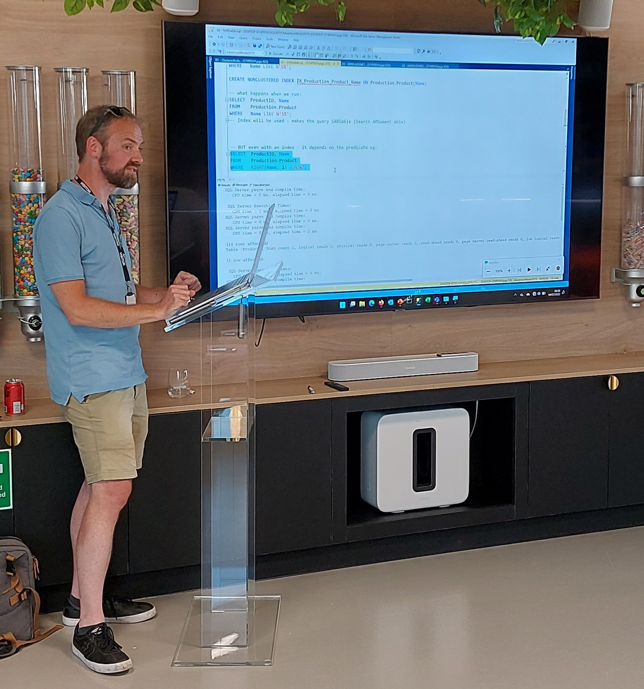

Phil Austin
Senior Consultant

Slide 3
Azure
Go to Azure.com
Click ‘Try Azure for free’
You will need:
An email address
A mobile phone
A credit/debit card – don’t worry you won’t be charged!
Choose United Kingdom or US region
$200 credit / 30 days
Some resources are free longer / permanently

Slide 4




Data engineering using your free credits
Res
SQL Server
Data Factory
Storage Account
Databricks
Resource group

Slide 5
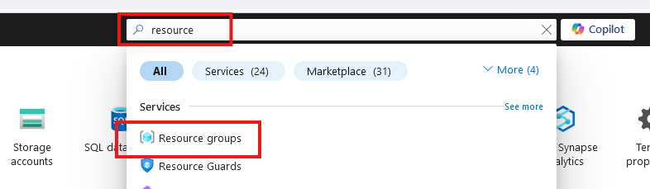
Create Resource Group

Slide 6
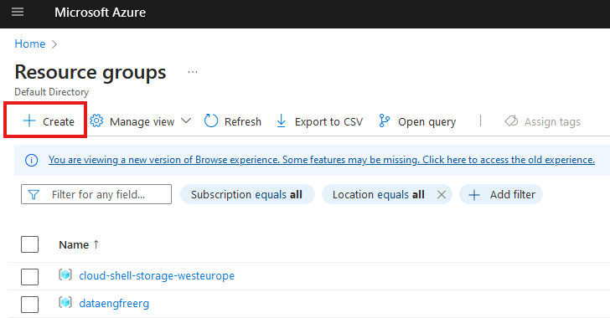
Create Resource Group

Slide 7
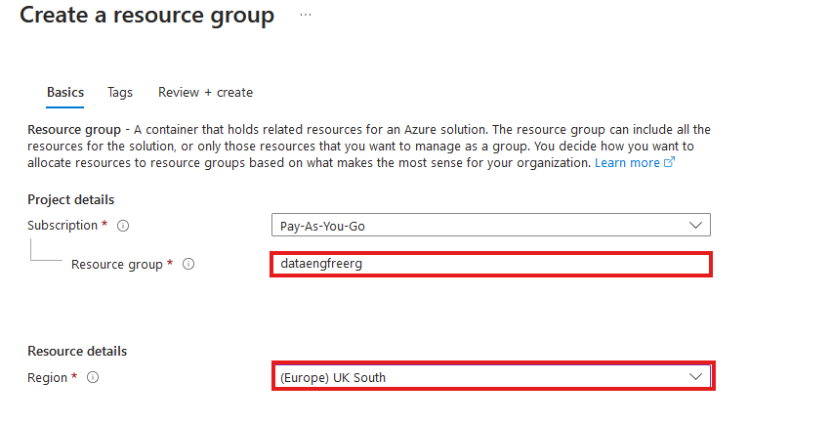
Create Resource Group

Slide 8
VS Code
Free download
Very large number of plug-ins/extensions – most free

Slide 9
Azure CLI
Install by following links from: https://learn.microsoft.com/en-us/cli/azure/install-azure-cli
For VSCode:
Azure CLI Tools
Azure Developer CLI

Slide 10
Data & Databases
Concepts to Learn: Data types, databases (SQL and NoSQL), data structures.
Tools/Resources:
Azure SQL Database - free tier available
Cosmos DB: Explore NoSQL databases with a limited free tier on Azure.

Slide 11
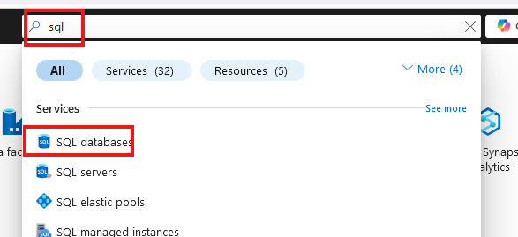
Create SQL database

Slide 12
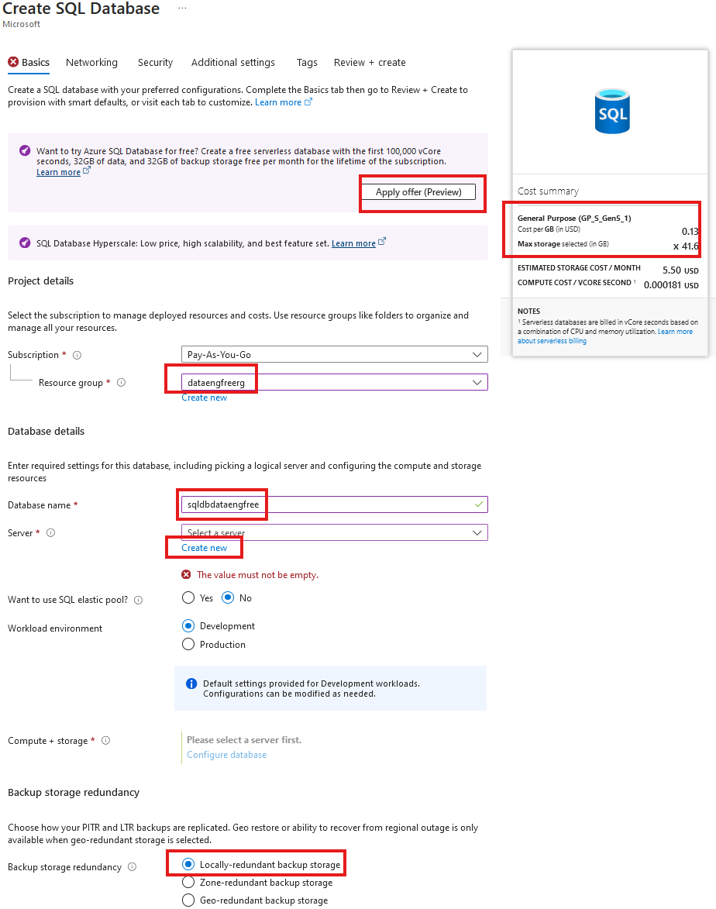
Create SQL database

Slide 13
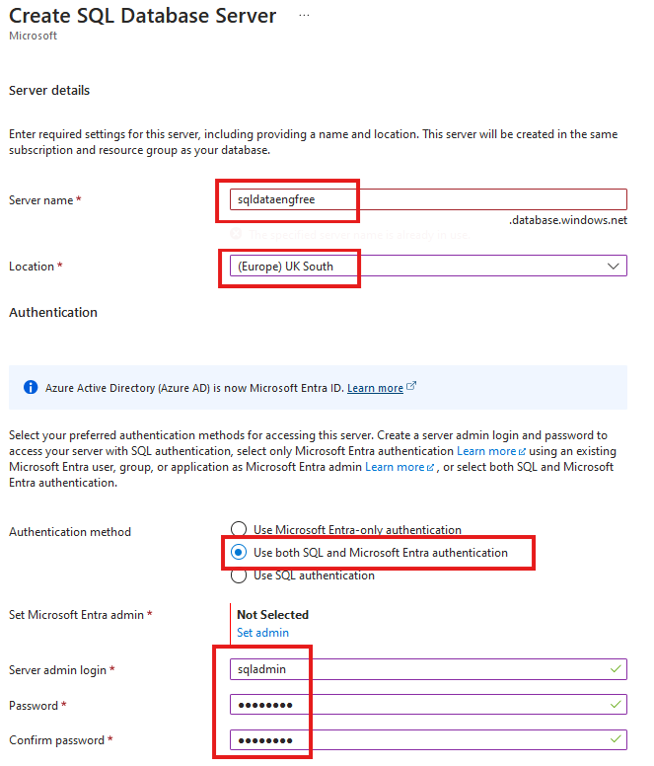
Create SQL database

Slide 14
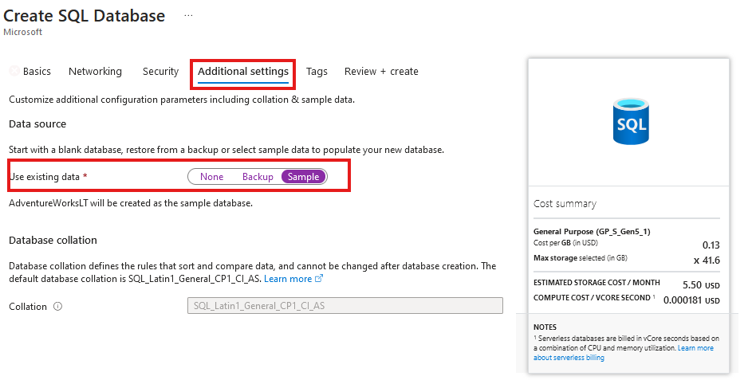
Create SQL database
Add sample data

Slide 15
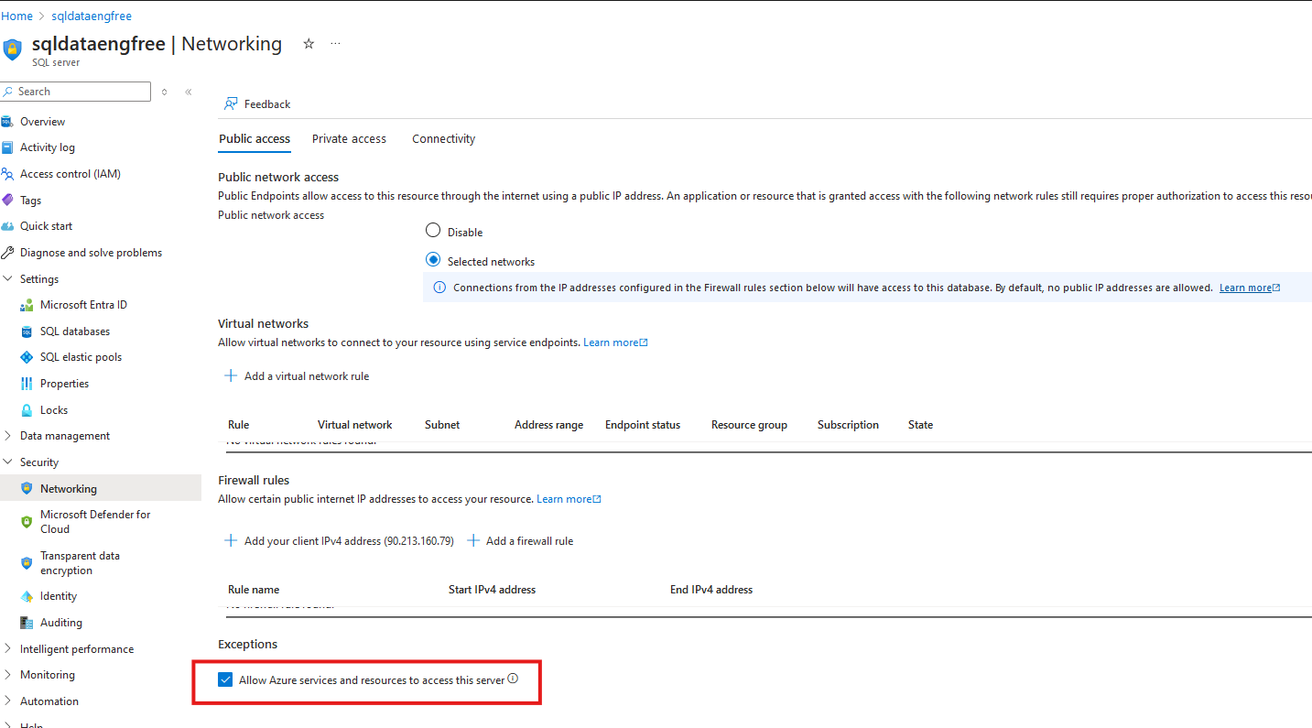

Slide 16
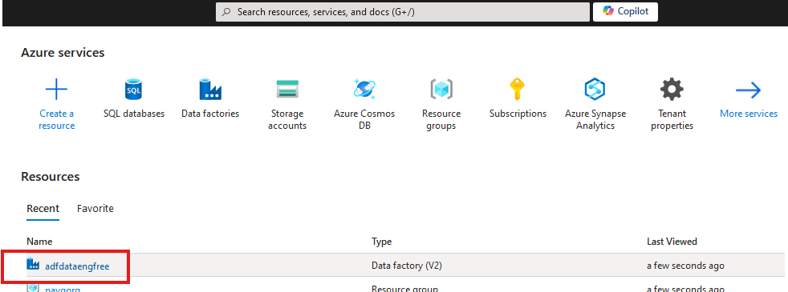


Slide 17
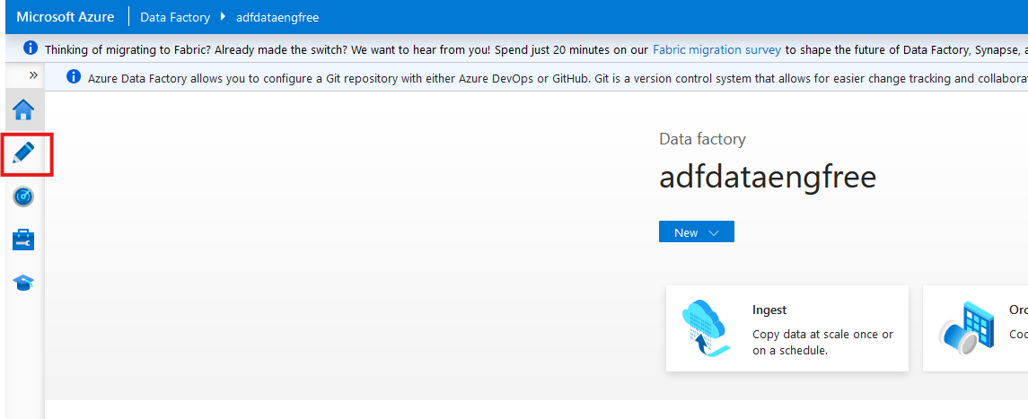

Slide 18
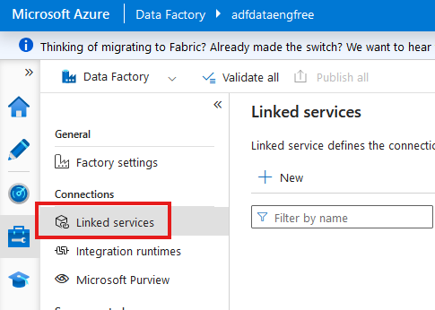

Slide 19
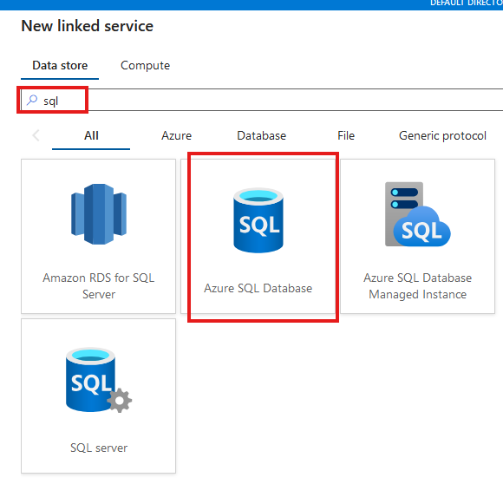

Slide 20
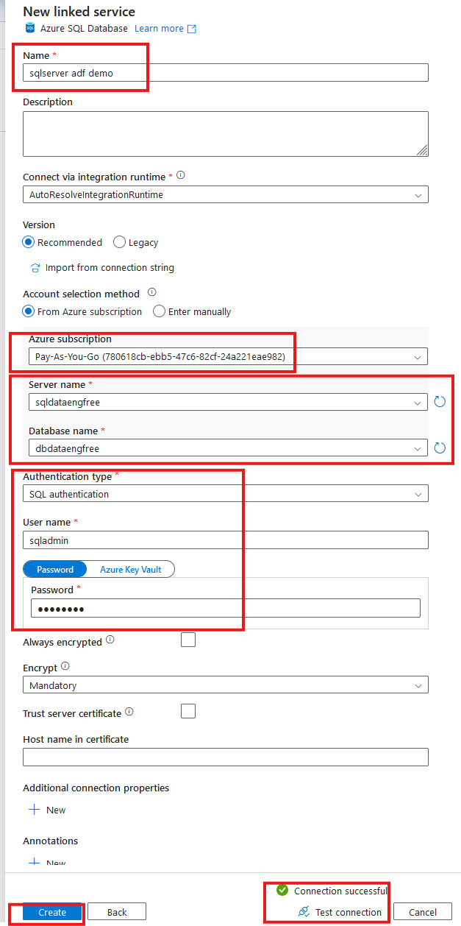

Slide 21
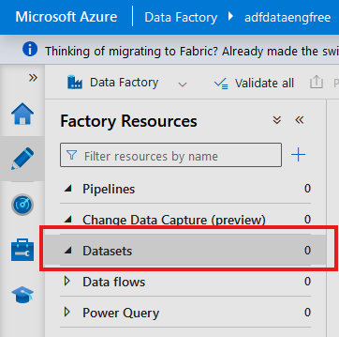
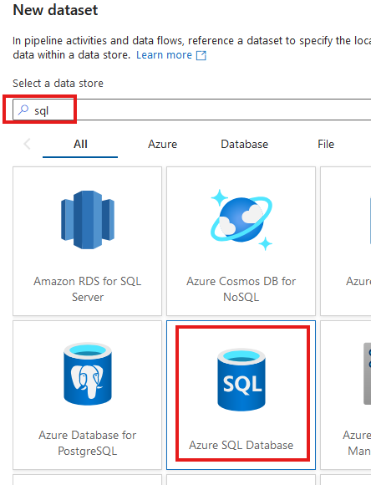

Slide 22
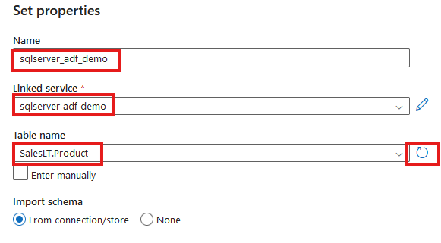

Slide 23
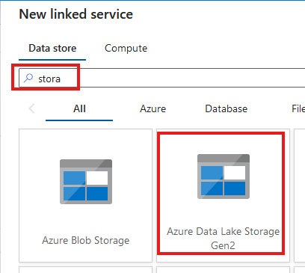
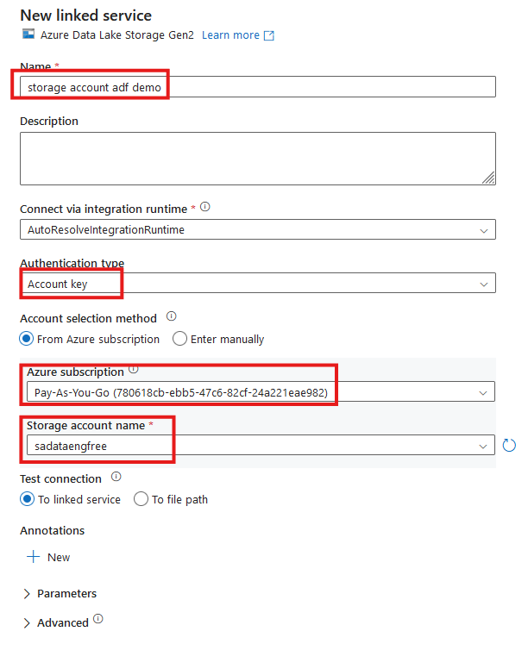


Slide 24
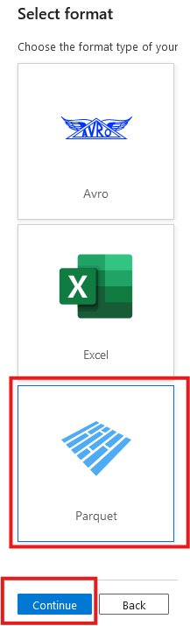
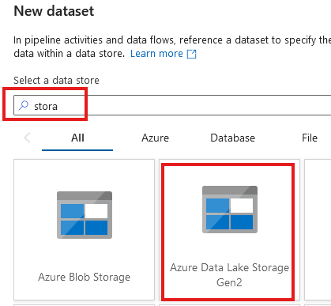

Slide 25
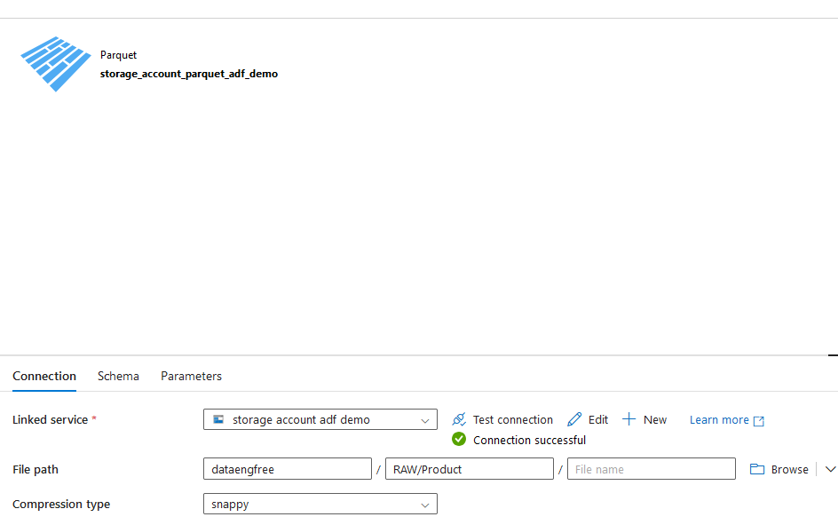

Slide 26
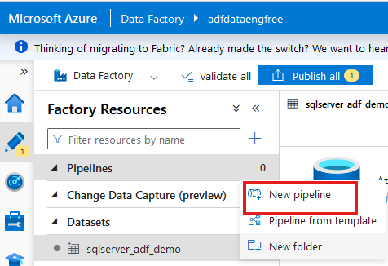
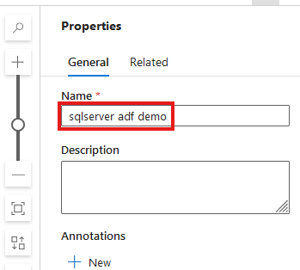

Slide 27
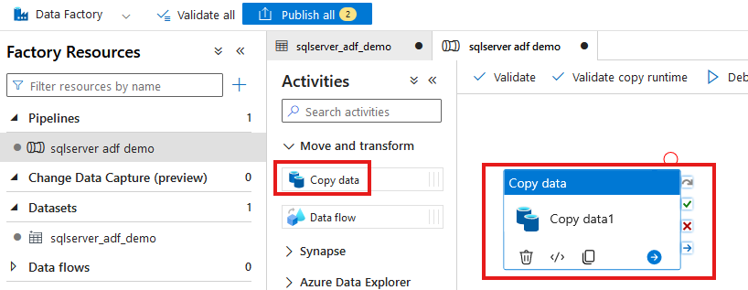

Slide 28
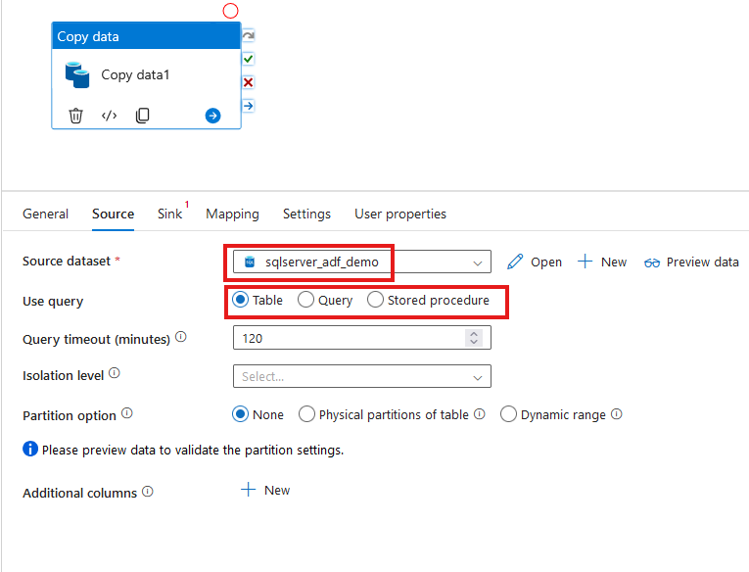

Slide 29
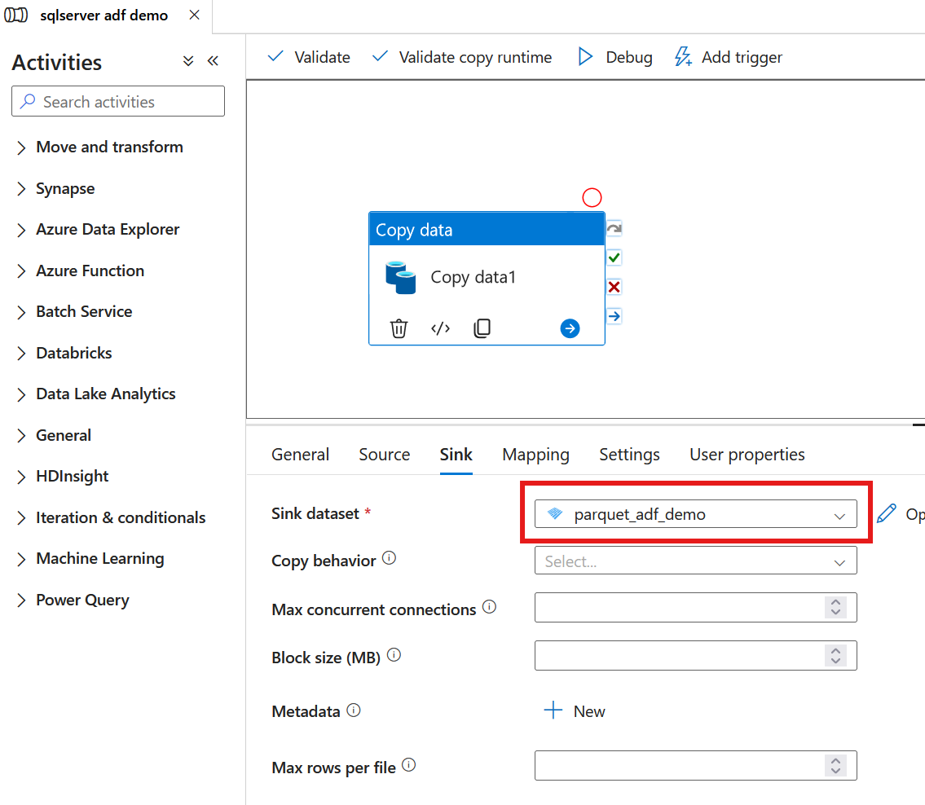

Slide 30
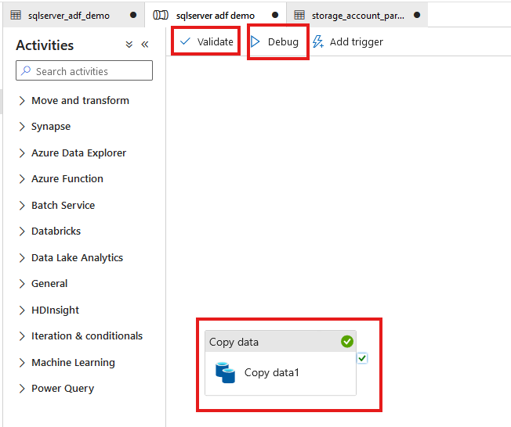

Slide 31
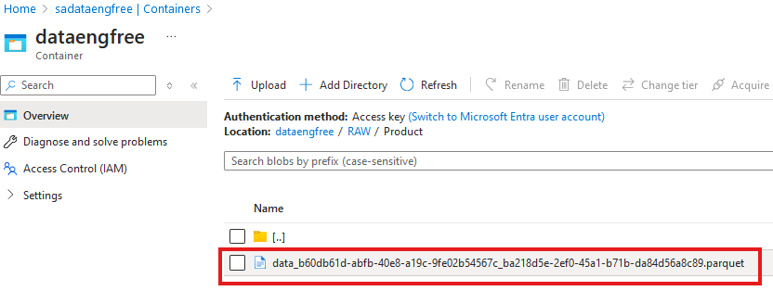

Slide 32
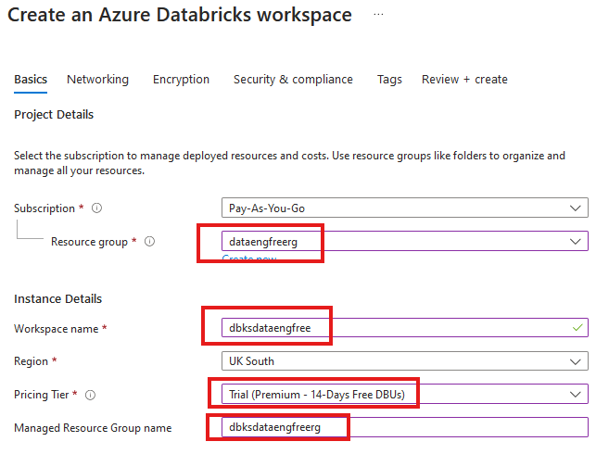


Slide 33
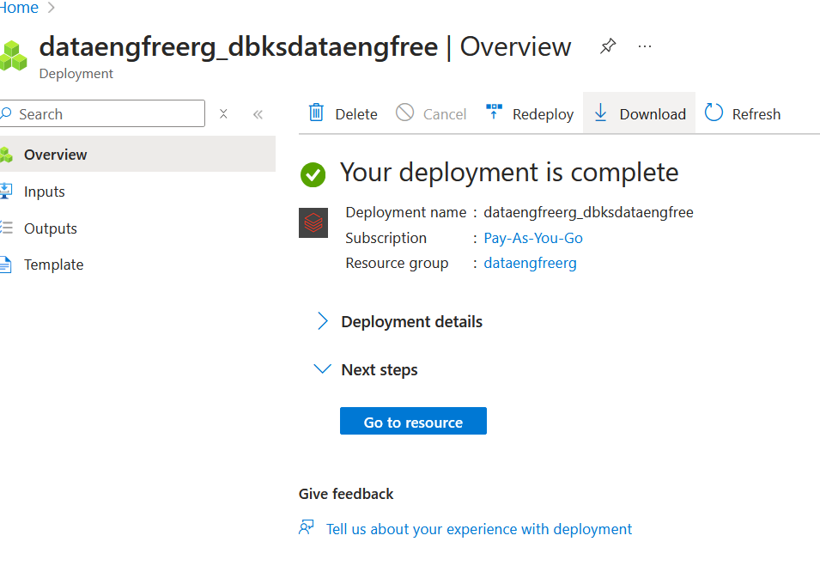

Slide 34
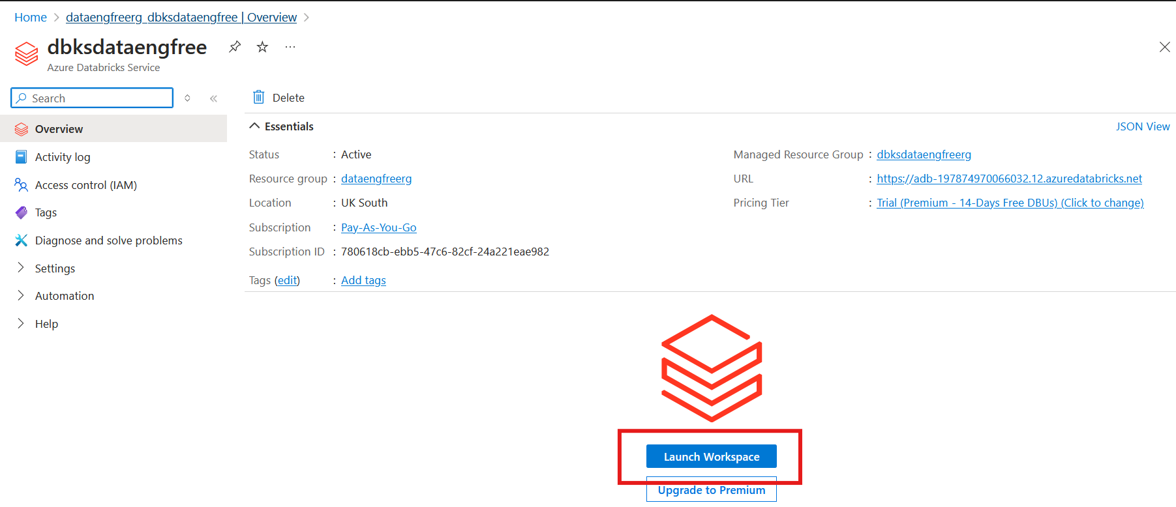

Slide 35
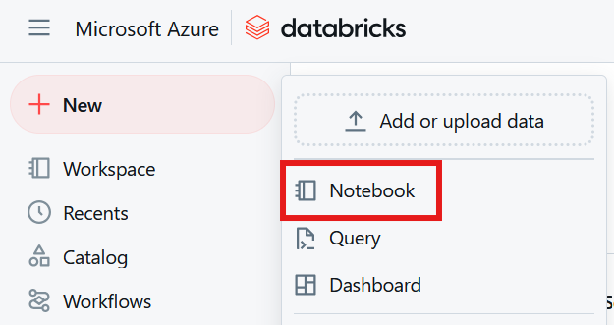

Slide 36
Python
Use Anaconda
Use conda to create environment
Might need to enable Long Paths

Slide 37
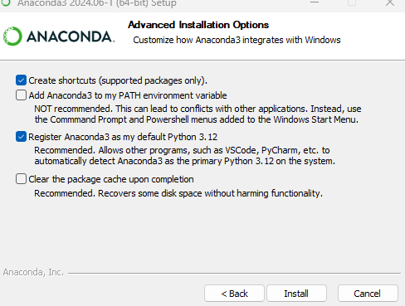
Anaconda install

Slide 38
Conda demo

Slide 39
PySpark Pre-requisites
Install Java (not v 21)
Set paths
JAVA_HOME
PATH
Install Apache Spark
Install winutils.exe
Create virtual environment
Instructions: https://sparkbyexamples.com/pyspark-tutorial/

Slide 40
PySpark Demo
Notes:
PySpark validation
Web UI
VS Code
- to run Jupiter notebooks needs ipykernel installed
- from vscode run conda install -n dataengforfree_env ipykernel
- copy python.exe > python3.exe
Visualisation?

Slide 41
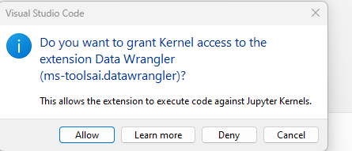

Slide 42
Follow-up Resources
Repo: https://github.com/phil-a10/Talks/tree/main/Data%20Engineering%20Using%20Free%20Tools
Microsoft Learn: https://learn.microsoft.com/en-us/training/career-paths/data-engineer
Kimball books

Slide 43
END

Slide 44
Azure CLI Demo

Slide 45
Create storage account
Create in same region as RG
Primary service is ADLS Gen 2
Primary workload Big Data Analytics
Performance: Standard
Redundancy: LRS
Add container > RAW directory

Slide 46
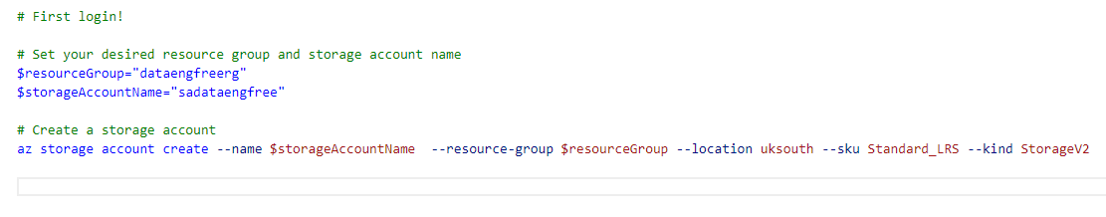
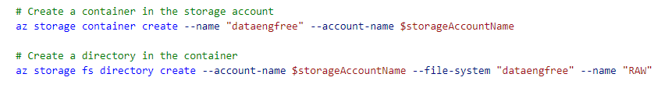
Create storage account

Slide 47
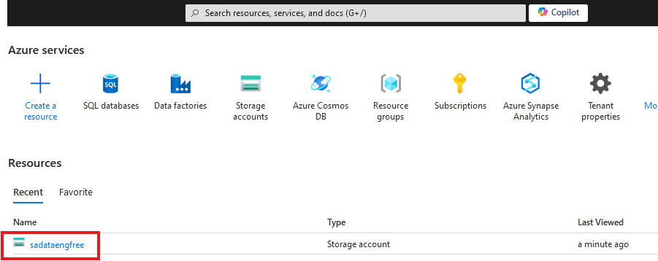

Slide 48
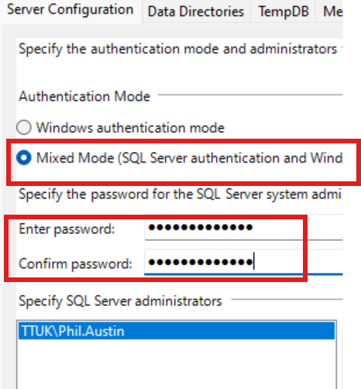

Slide 49
Create Azure Data Factory
Create in same region as RG

Slide 50
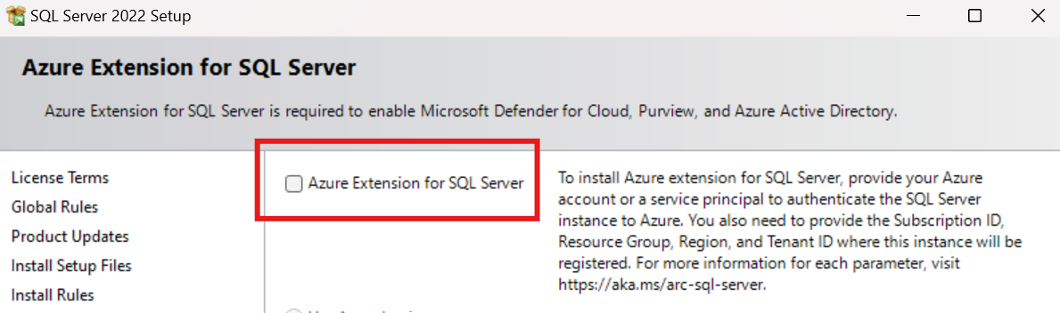
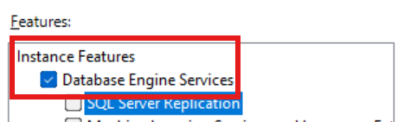
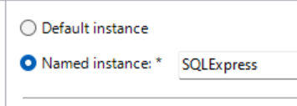

Slide 51
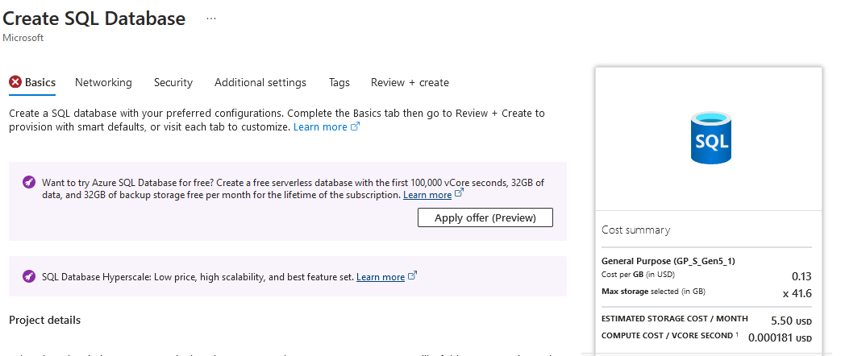

Slide 52
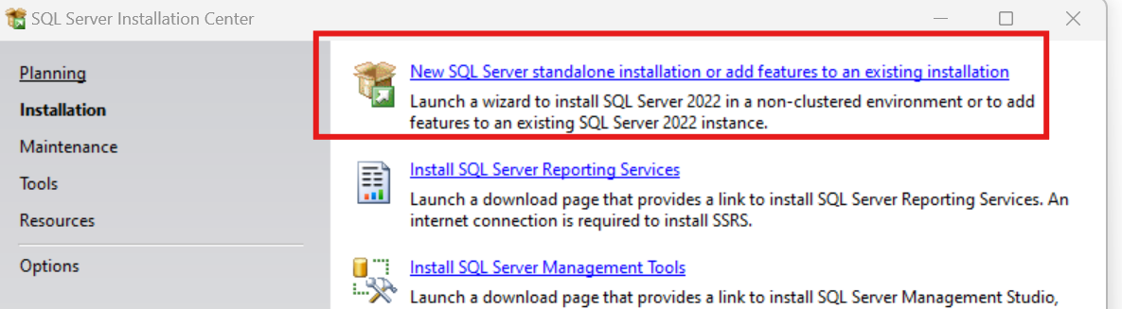
SQL Express!
https://www.microsoft.com/en-us/download/details.aspx?id=104781&lc=1033

Slide 53
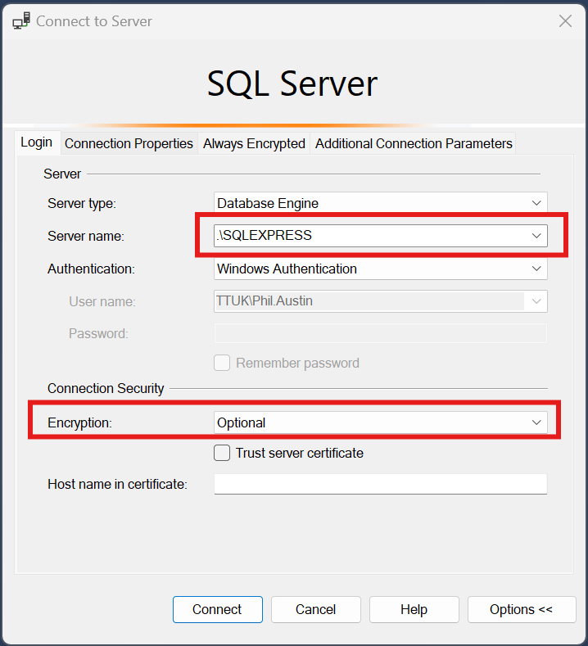

Slide 54
Download JDBC driver: https://repo1.maven.org/maven2/com/microsoft/azure/spark-mssql-connector_2.12/1.2.0/spark-mssql-connector_2.12-1.2.0.jar
Copy jar file to anaconda jars folder

Slide 55
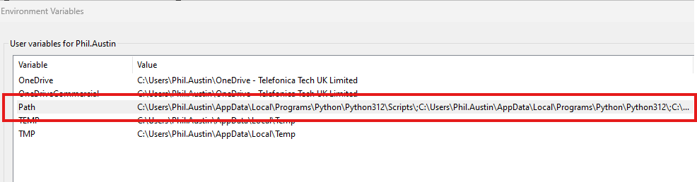
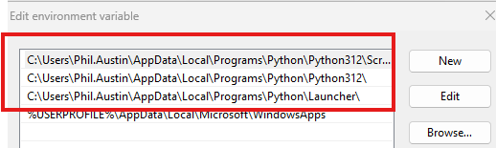
Python pre-reqs

Slide 56
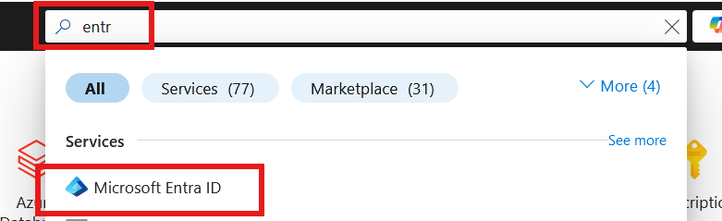
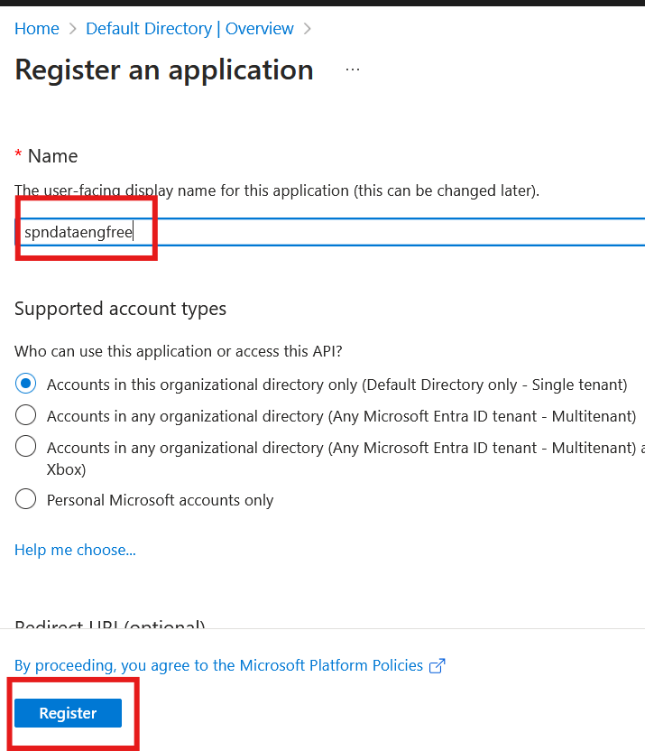

Slide 57
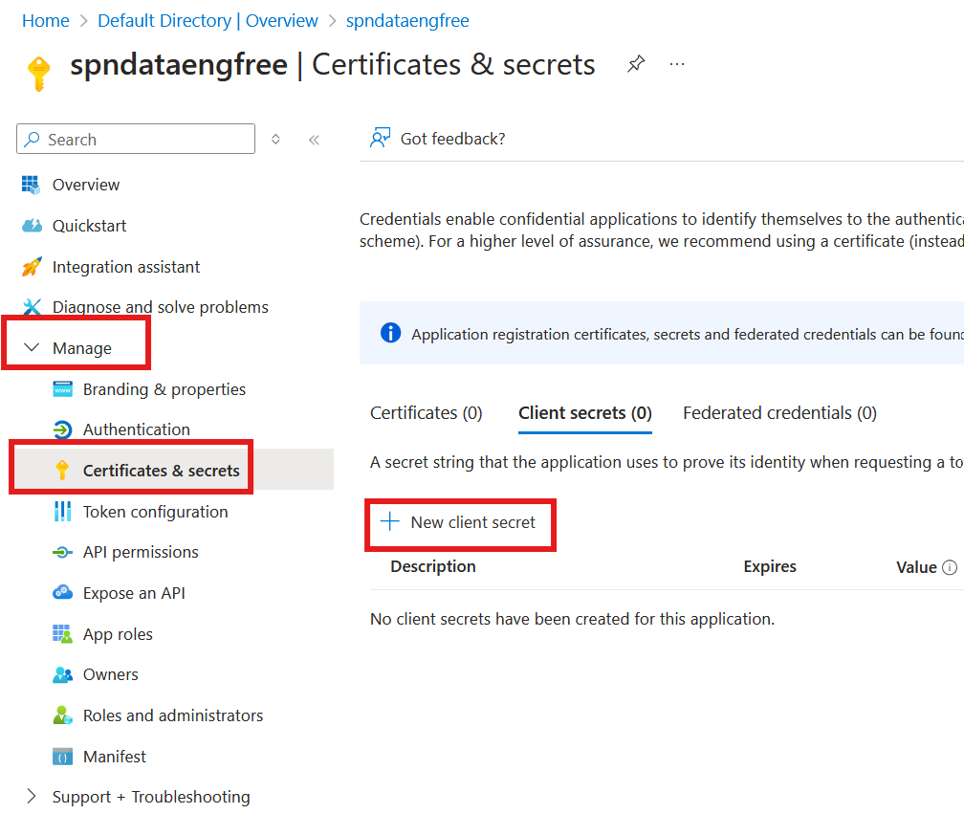


Slide 58



Slide 59


Slide 60

Create storage account

Slide 61

Create storage account

Slide 62

Create storage account

Slide 63



Slide 64


Create Azure Data Factory (ADF)

Slide 65
Create Azure Data Factory (ADF)

Slide 66

Create Azure Data Factory (ADF)

Slide 67


Slide 68


Slide 69


Slide 71
PySpark

